Slide 1

THE CHICKEN DINNER DILEMMA What if the next pandemic isn’t a virus—but a resistant bacteria already on your plate?

Slide 2
DNA SEQUENCE ALIGNMENT FOR ANTIMICROBIAL RESISTANCE TECHNOLOGY
Lina Guezi, Dante Garcia, Margaux Martin-Prevel, Zahra Borhani

Slide 3


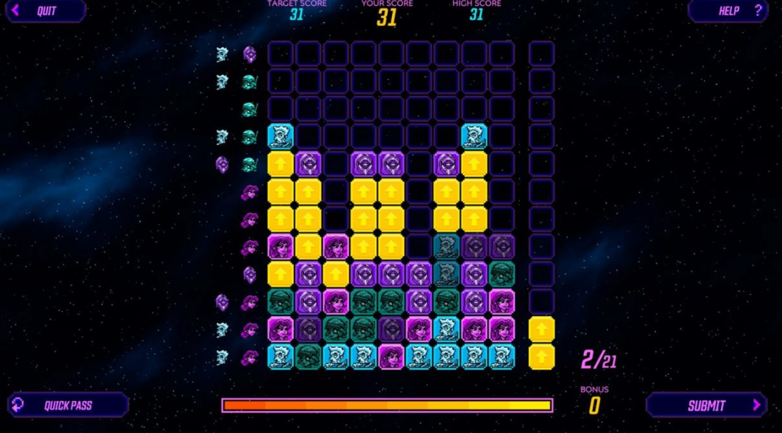
CONTENT
1. Gene Modification
2. Model Training
3. Results
4. Application of the Model

Slide 4
1
Gene Modification
And how it leads to AMR

Slide 5
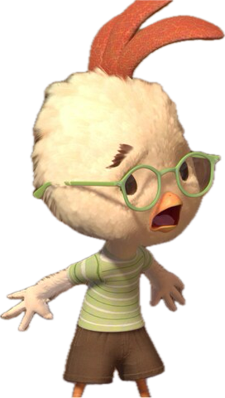
CAUSES OF AMR
1
Mutations in Existing Genes
Mobile Genetics Elements
3
2
Horizontal Gene transfer
Point Mutation
Gene Amplification
Transposons
Transformation
Bacteriophage
Conjugation

Slide 6
2
Model training
Our Approach to training the model

Slide 7
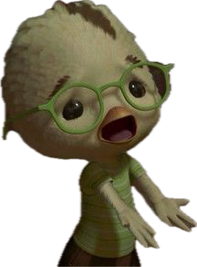
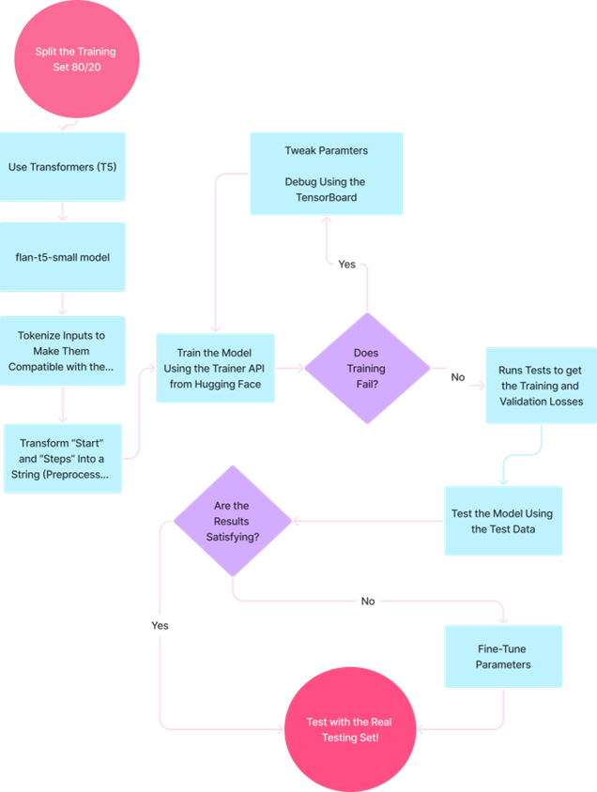

Slide 8
COMPUTATIONAL APPROACH: T5
Strategy:
1. Data Preparation: Tokenization and Formatting.
- divide the data into 80% training and 20% validation.
- the Puzzle class transforms the steps into a format that can be fed into the T5 Transformer
2. Tokenize inputs
- Since T5 works with text, the raw sequence data is converted into tokenized inputs
3. Preprocess input:
- Reduce noise
4. Use Transformer (T5)
- the alignment task in the puzzle works as a sequence-to-sequence problem
- the T5 model Learns how to modify to create a solution
5. Model Evaluation:
- check if alignment is correct
If not retry adjustment

Slide 9
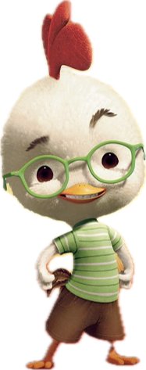
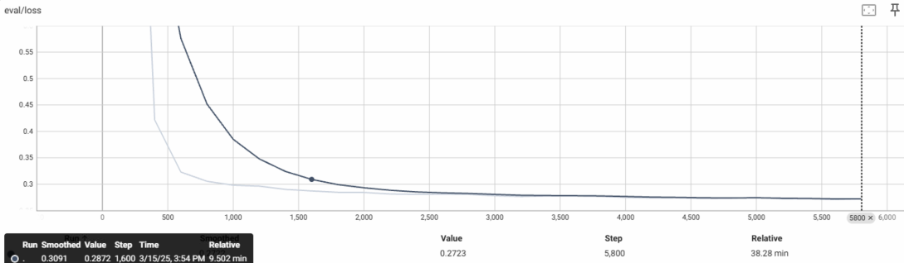
COMPUTATIONAL APPROACH: T5
Figure #1: Evaluation and Loss using the FLAN-T5 Transformer

Slide 10

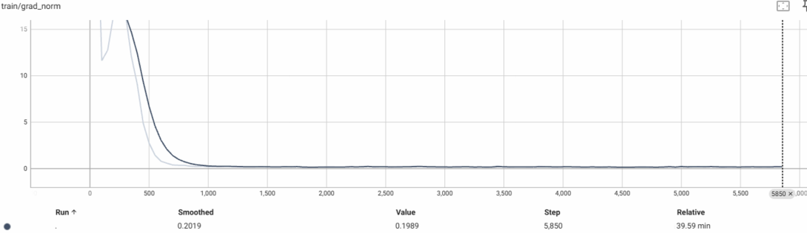
COMPUTATIONAL APPROACH: T5
Figure #2: Training Vs Grad_norm using the FLAN-T5 Transformer

Slide 11

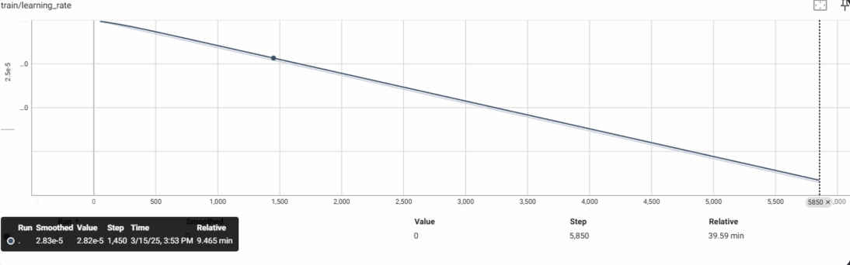
COMPUTATIONAL APPROACH: T5
Figure #3: Training Vs Learning rate using the FLAN-T5 Transformer

Slide 12
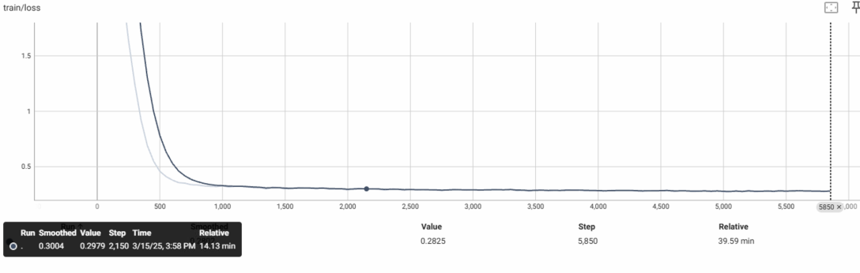

COMPUTATIONAL APPROACH: T5
Figure #4: Training Vs loss rate using the FLAN-T5 Transformer

Slide 13
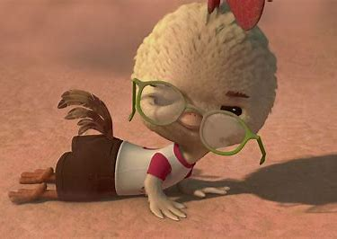
COMPUTATIONAL APPROACH: QWEN
Strategy:
1. Data Preparation: Tokenization and Formatting.
- divide the data into 80% training and 20% validation.
2. Tokenize inputs
- the raw sequence data is converted into tokenized inputs
3. Preprocess input:
- Reduce noise
4. Use Transformer QWEN
- Train the model using API
- predict the final aligned sequence based on Borderlan Science data
5. Model Evaluation using autoregressive testing:
- check if alignment is correct
- If not retry adjustment

Slide 14
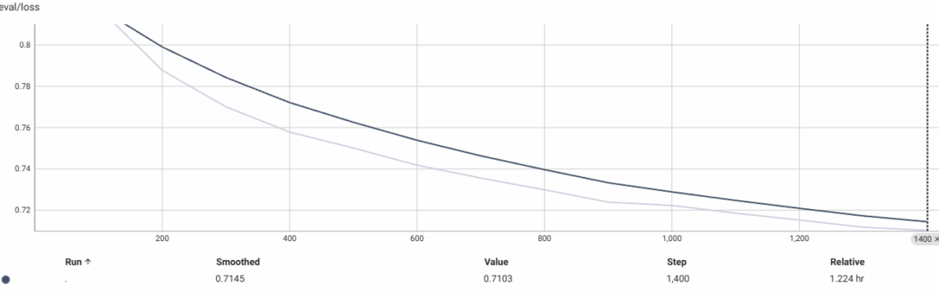
COMPUTATIONAL APPROACH: QWEN
Figure #5: Evaluation vs. loss rate using the QWEN Transformer Decoder

Slide 15
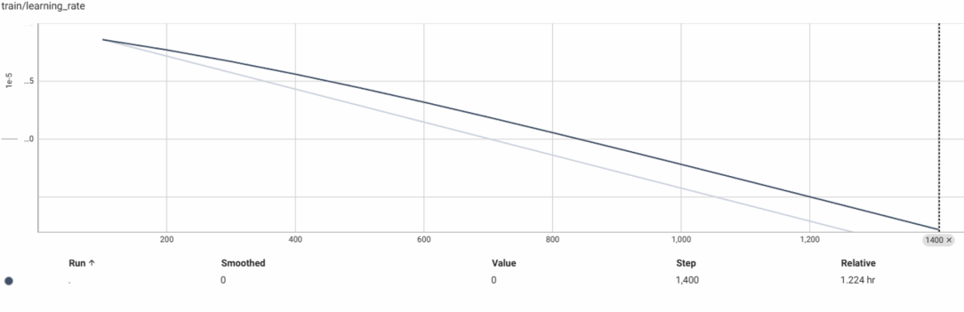
COMPUTATIONAL APPROACH: QWEN
Figure #6: Training Vs learning rate using the QWEN Transformer Decoder

Slide 16
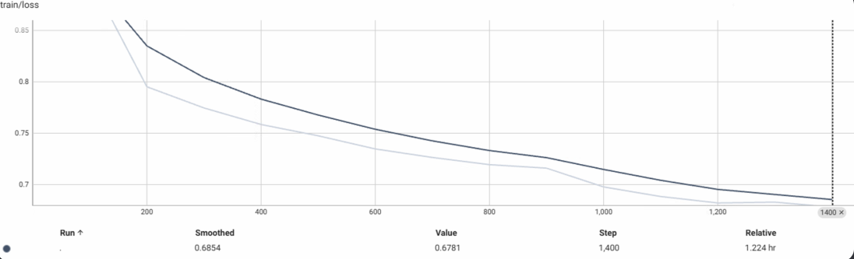
COMPUTATIONAL APPROACH: QWEN
Figure #7: Training vs. loss using the QWEN Transformer Decoder

Slide 17
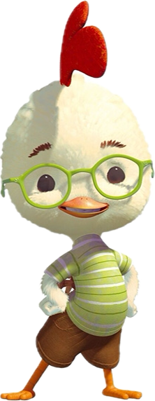
THE CHALLENGES WITH THE MODEL:
Challenge#1: MSA is an NP-hard problem, meaning the complexity grows exponentially with more sequences.
Solution: Use ML to optimize/accelerate the process
Challenge#2: Deciding where to insert the gaps (-)
Solution: Used a Transformer (FLAN-T5--) model to recognize optimal gap placement
Used a Transformer decoder QWEN, for the second training model
Challenge#3: The model might overfit to training sequences and fail on unseen data.
Solution: Stopped the model after its straining loss entered a plateau
Challenge #4: Faster algorithms may sacrifice alignment accuracy while more accurate models (deep learning-based) may be too slow for practical use.
Solution: Optimized models for parallel computing GPU
Challenge#5: Handling noisy, incomplete, and crowdsourced data
Solution: Applied Preprocessing Filters to reduce null values

Slide 18
3
RESULTS
And interpretations

Slide 19
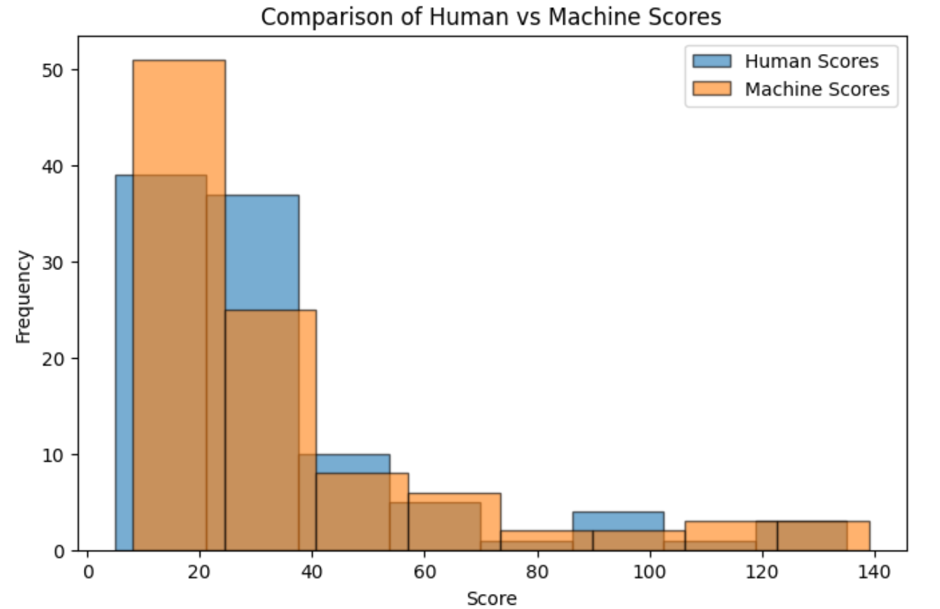
RESULTS
Figure #8: Human Vs Machine Scores using the FLAN-T5 Transformer

Slide 20
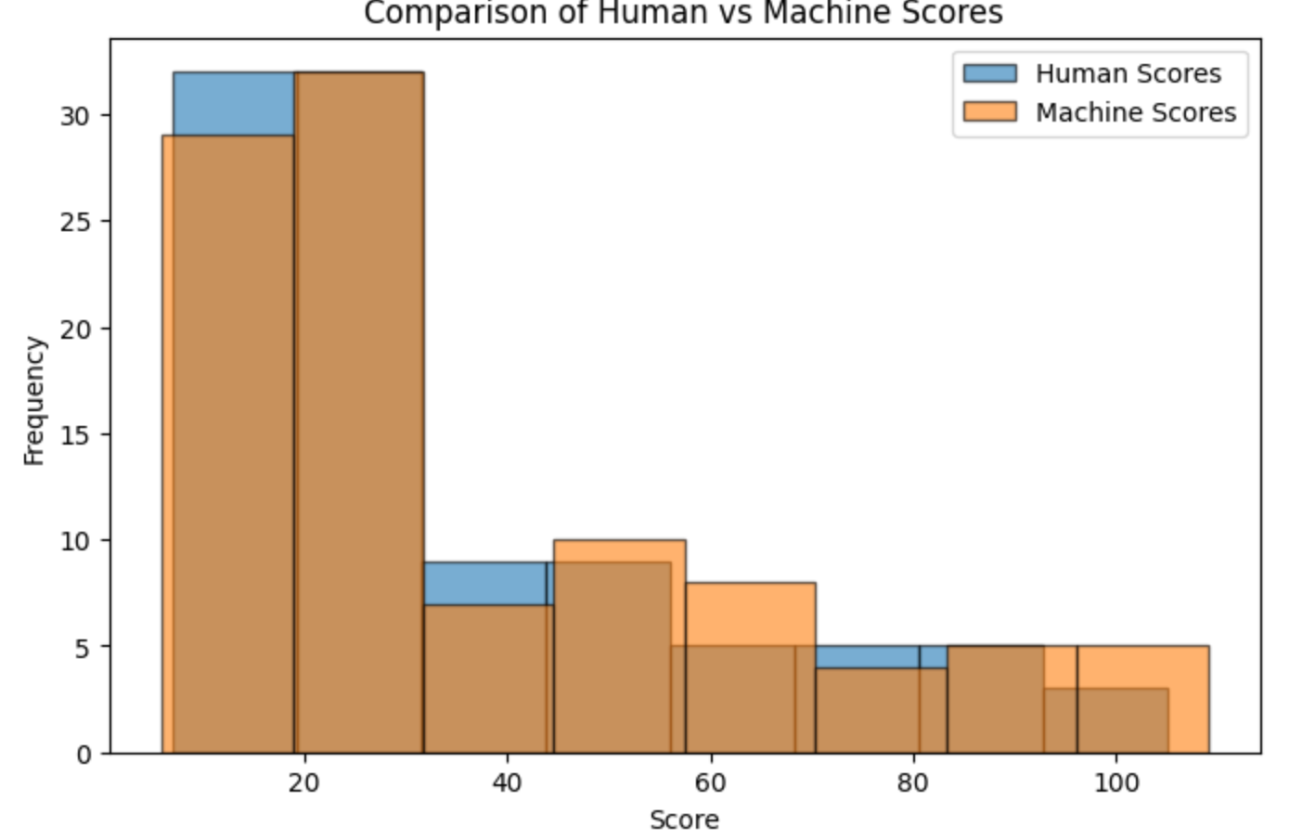
RESULTS
Figure #9: Human Vs Machine Scores using the Qwen Transformer Decoder

Slide 21
4
Applications of the Model
How can this Model be useful?

Slide 22
REAL-WORLD APPLICATIONS
PREVENTION
REMEDIATION
Tracking spread of AMR (healthcare, agriculture)
predict treatment failure
avoid unnecessary exposure
Pharmaceutical Targeted Drugs
Future resistance predictions
GENE THERAPY

Slide 23
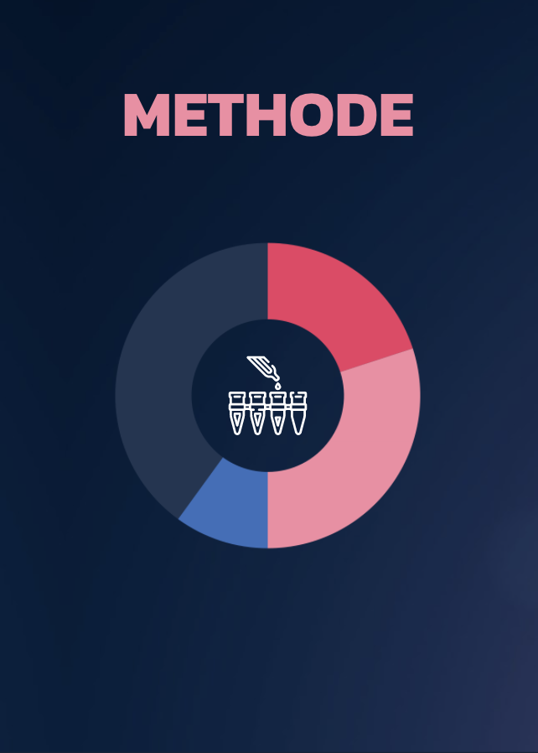
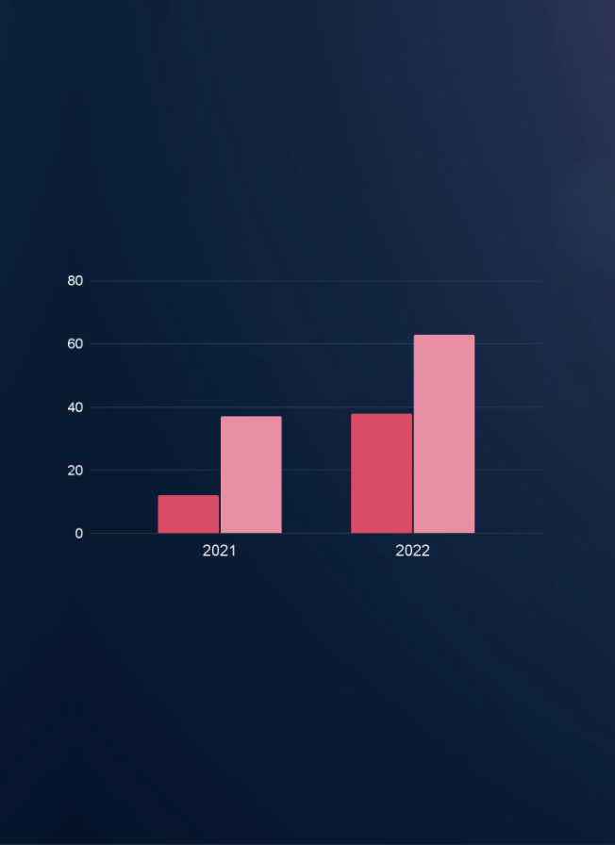
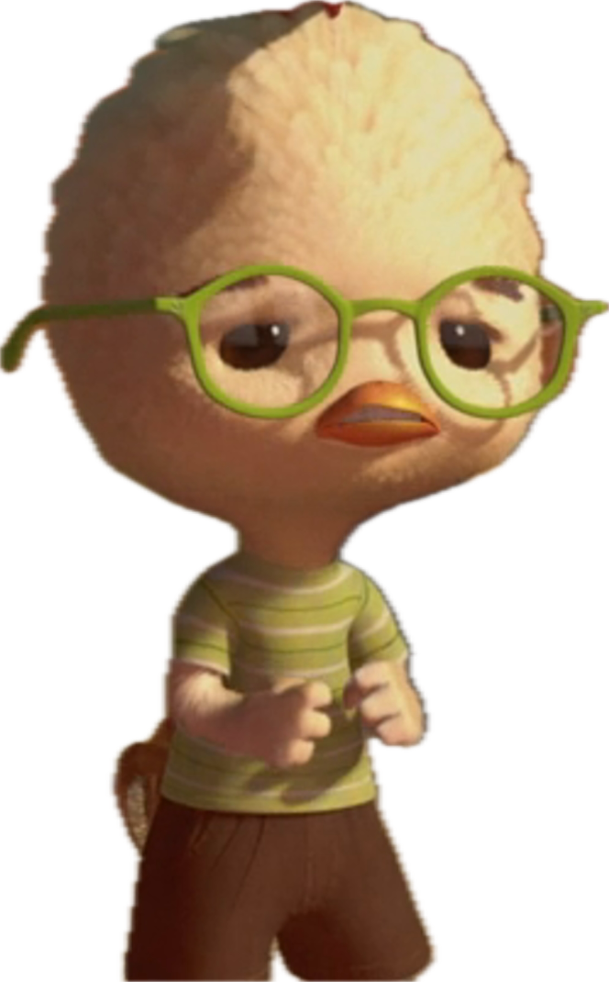
CONCLUSION
Machine Learning is evolutionary in healthcare
The Machine Scores could be optimized in comparison to humans using different ML models
Applications in the real world.
We love chicken!

Slide 24
SOURCES
Ogata, K. et al. (2012). Commercially Distributed Meat as a Potential Vehicle for Community-Acquired Methicillin-Resistant Staphylococcus aureus. Applied and Environmental Microbiology, 78(8), 2797-2802. https://doi.org/10.1128/AEM.07470-11
Dixit, O. V. A. et al. (2024). Diversity of antimicrobial-resistant bacteria isolated from Australian chicken and pork meat. Frontiers in Microbiology, 15. https://doi.org/10.3389/fmicb.2024.1347597
Naghavi, M. et al. (2024). Global burden of bacterial antimicrobial resistance 1990-2021: a systematic analysis with forecasts to 2050. The Lancet, 404(10459), 1199-1226. https://doi.org/10.1016/S0140-6736(24)01867-1
PHOTOS:
Borderlands Science visuals
Various Little Chicken screenshots

Slide 25

THANK YOU!

